Slide 1
Module 0
Matrix / Tensor Algebra
Notes:
Guidelines
Use section headers to chunk content in your presentation.
Use the same style of section header throughout your presentation.
Keep your title to no more than 2 lines.

Slide 2
For the following vectors: x = [1,-2] And y = [3, 2] Find x'y
ⓘ Start presenting to display the poll results on this slide.

Slide 3
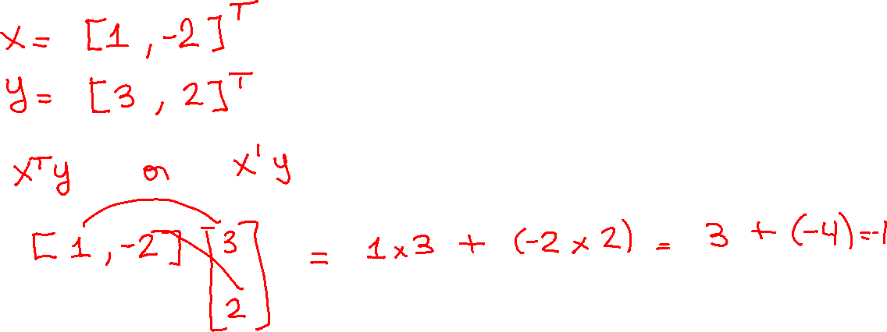

Slide 4
For the following vector: x = [2,1,7,-2] find ||x||_2
ⓘ Start presenting to display the poll results on this slide.

Slide 5
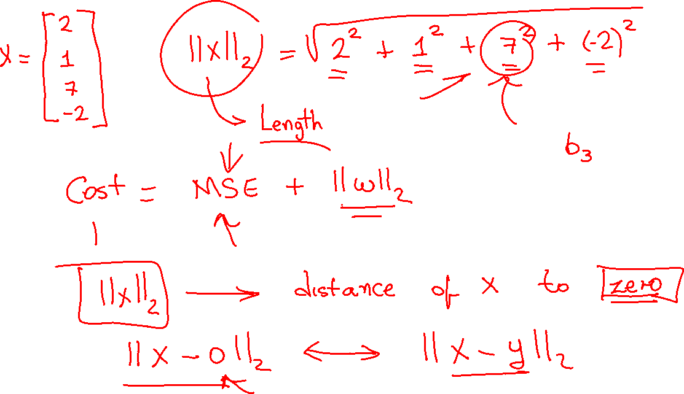

Slide 6
For the following vector: x = [2,1,7,-2] find ||x||_1
ⓘ Start presenting to display the poll results on this slide.

Slide 7
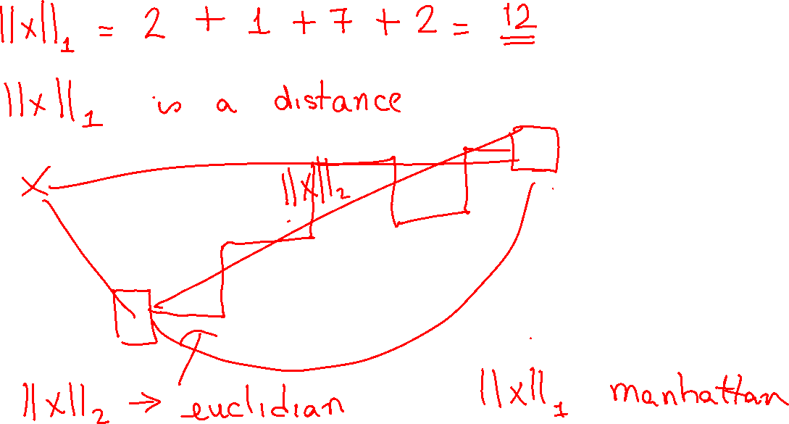

Slide 8
What is the shape of the matrix?
ⓘ Start presenting to display the poll results on this slide.

Slide 9
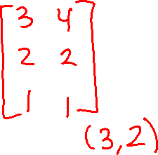

Slide 10
Is the following matrix multiplication valid (conformable)
ⓘ Start presenting to display the poll results on this slide.

Slide 11
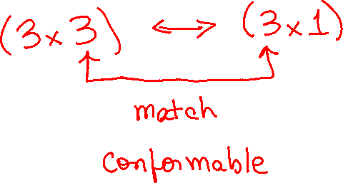

Slide 12
What is the shape of the resulting matrix?
ⓘ Start presenting to display the poll results on this slide.

Slide 13
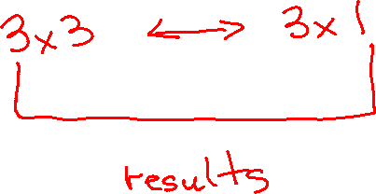

Slide 14
Is the matrix here singular (dependent)?
ⓘ Start presenting to display the poll results on this slide.

Slide 15
